Slide 1



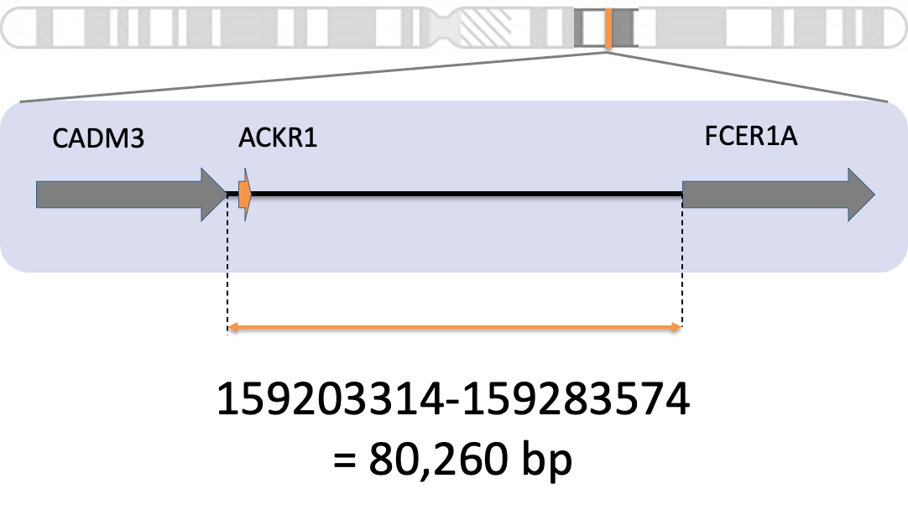
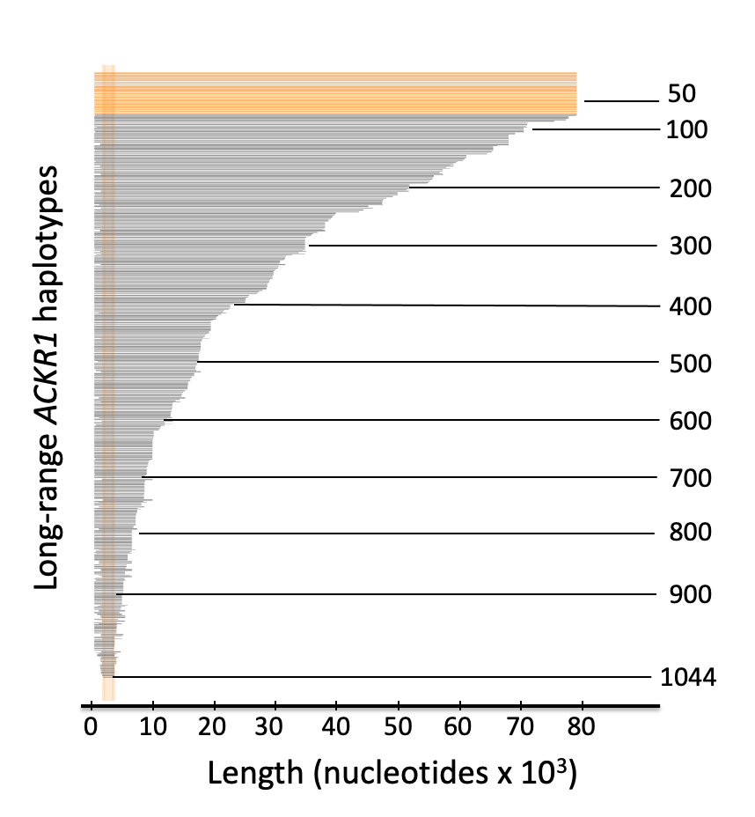
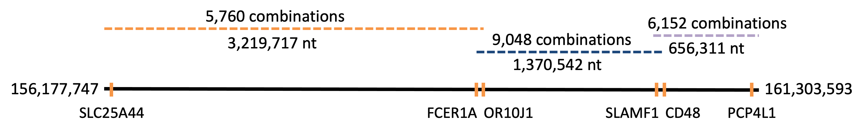
HapPy: an Algorithm for Chromosome-Scale Haplotype Reconstruction using Experimentally Verified Sequences from the 1000 Genomes Project
Anne-Sophie Fratzscher^{1,2}, Kshitij Srivastava¹, Willy A. Flegel¹
¹Department of Transfusion Medicine, NIH Clinical Center, National Institutes of Health, Bethesda, MD
²McGill University, Montréal, QC
Goals
Methods
Conclusions
Identify conserved haplotype sequences across 26 different populations from the 1000 Genomes Project for 100 genes on the long arm of chromosome 1
Construct consensus sequences from overlapping full-length haplotypes of those 100 genes
Figure 1: Diagram of the HapPy Pipeline
Description
HapPy can identify long-range haplotypes for 100 genes on the long arm of chromosome 1 that are not affected by known errors of computerized genotype phasing
These long-range haplotypes can be used as references for genes (e.g. ACKR1) that lack long references
A consensus sequence spanning the entire region was generated with two breaks, and this sequence captures genetic differences from different human populations
1. Select genes
Download locations of genes on chromosome 1
Analyze SLC25A44 to PCP4L1 = 100 genes = 156,177,747:161,303,593 = 5,125,846 nt (2% chr 1)
.
2. Compute long-range haplotypes for genes
Select region between end of previous gene and start of next gene
Haplotypes are regions with complete homozygosity or a single heterozygous SNV
.
3. Combine full-length haplotypes
Extract full-length haplotypes for each gene
If two haplotypes have 100% sequence identity in overlapping region, combine them
Keep extending consensus sequence until the last gene is reached
GRCh38 assembly
select a gene (e.g. ACKR1)
Background
Haplotypes are sets of single nucleotide variations (SNVs) that are inherited together from a parent
Can be used to understand genetics of disease
Also important for blood group matching
Haplotype phasing is the process of inferring haplotypes from genotype data
Mostly done computationally due to cost and time of lab-based methods
Relies on correct reference sequence
.
The current human reference genome, Homo sapiens genome assembly GRCh38 (hg38), was released in 2013
Multiple concerns with the current reference genome:
Does not fully reflect human genetic diversity
70% from one individual
Most blood groups lack long reference sequences
.
Long contiguous stretches of homozygosity (LCSHs) are regions that contain at most one heterozygous SNV
Why are they interesting? -> presence of LCSHs in unrelated individuals across different populations is attributed to a lower average recombination rate in those regions of the genome
.
The 1000 Genomes Project (1kGP) ran between 2008 and 2015 and sequenced 2504 unrelated individuals in Phase 3 dataset
Goal was to create a public database of human genetic variation ¹
Improved dataset was released in 2020 -> 2504 individuals from 1kGP Phase 3 + 698 additional samples = 3202 individuals
30x coverage (vs. 7.4X coverage for 1kGP Phase 3) discovers over two-fold more SNV sites
.
LCSHs were previously extracted from the 1kGP and were used to identify experimentally confirmed reference sequences for the Duffy gene (ACKR1) ²
Clinical Implications
Use ACKR1 haplotypes as references to facilitate blood group genotyping between donors and recipients
Exact matching improves survival after bone marrow transplantation and reduces alloimmunization
A more diverse reference genome could aid population-specific studies on genetic predisposition to diseases ³
May aid in development of personalized medicine ³
get results for all genes
1kGP 30x
extract full-length haplotypes
genotype data for gene (3202 individuals)
overlaps
Future Directions
Explore improved heuristics to generate a consensus sequence spanning the entire region without any breaks
Expand to the remaining genes on chromosome 1, eventually to all genes to generate a more genetically diverse reference genome as an alternative to hg38
Generate reference sequences unique to the five super- populations (African, American, East Asian, European, South Asian)
Use machine learning to predict risk of certain diseases
combine
consensus sequences
repeat for other genes
Results
References
Acknowledgements
Long-range haplotypes (+ frequency and population information) were generated for 100 genes
At least one full-length haplotype was generated for each gene
Attempting to find all possible combinations led to exponential increase in possibilities
A heuristic was developed to try to solve the problem:
Full-length haplotypes are ranked by frequency
Sum ranks of the current consensus sequences and full-length haplotype when extending
If the number of consensus sequences exceeds 10,000 instances, keep only the top 10,000
Using this heuristic, a consensus sequence with two breaks was constructed (Figure 2)
¹1000 Genomes Project Consort. et al. (2015). A global reference for human genetic variation. Nature, 526(7571), 68-74
²Srivastava K, Fratzscher AS, Lan B, Flegel WA. (2021). Cataloguing experimentally confirmed 80.7 kb-long ACKR1 haplotypes from the 1000 Genomes Project database. BMC Bioinformatics, 22(1), 273.
. ³Hindorff L, Bonham V, Brody L, et al. (2018). Prioritizing diversity in human genomics research. Nature Reviews. Genetics, 19(3), 175-185
I would like to thank Dr. Flegel and Dr. Srivastava for their great mentorship and their support throughout this project.
Thank you also to the NIH SIP for the exceptional training in this unique year.
Contact
Figure 2: Constructed consensus sequences span the entire region
anne-sophie.fratzscher
@mail.mcgill.ca
Notes:
Good morning everyone. My name is Anne-Sophie, I work in the DTM under Dr. Flegel and Dr. Srivastava. Today, i will be presenting HapPy, which is an algorithm that uses sequences from the 1000GP for chromosome-scale haplotype reconstruction.
INTRO
So first, let me give you some background. When we sequence a person’s genome, we get genotypes, but genotypes dont tell us which SNVs are inherited together. This info is important bc knowing which SNVs are inherited together is essential to understanding the genetics of diseases. This is why we need something called haplotype phasing, which is the process of inferring haplotypes from genotype data. Most haplotype phasing approaches rely on correct reference sequences.
The current reference genome, which is called hg38, has multiple issues, including the fact that it lacks genetic diversity due to 70% of it coming from one individual, and it lacks long reference sequences for most blood groups. As a result, our lab previously generated references for the Duffy gene by identifying LCSHs, which are regions containing <= 1 heterozygous SNV. LCSHs are interesting bc, if they are found in unrelated individuals across different populations, they have a lower average recombination rate.
Due to our results being very successful in identifying references for the Duffy gene, we wanted to expand our program, which call HapPy, so that it can generate a more diverse reference genome.
METHODS
Now, lets take a look at how HapPy works. So, for this project, we focused on the 100 genes surrounding ACKR1. First, HapPy downloads the locations of these 100 genes from NCBI. Then, the region between the end of the previous gene and the start of the next gene is selected, and this region is downloaded from the 1000GP for all 3202 individuals. HapPy then finds unique long continuous stretches of homozygosity from this data, which produces something called long-range haplotypes as you see here. This is then repeated for all 100 genes. After we have all these long-range haplotypes, HapPy selects only full-length haplotypes (which are haplotypes that span this whole region). It then finds overlaps between these regions and tries all possible combinations , producing consensus sequences.
RESULTS
Moving on to the results. HapPy was able to generate long-range haplotypes for all 100 genes, and at least one full-length hpalotype for each gene.
When we tried to find all possible combinations between neighbouring haplotypes, we ran into a problem. There was an exponential increase in possible combinations as we tried to append more haplotypes to the sequence. As a result, we tried to develop a heuristic (which is a way of finding any solution, but not necessarily the optimal solution). In our heuristic, full-length haplotypes were ranked by their frequency and, when we tried to find combinations, we would sum the rank of the sequence so far with the rank of the next haplotype. If this number exceeded a threshold, we only kept the top 10,000 instances. Using this heuristic, we were able to generate a consensus sequence with only 2 breaks that spanned this entire region (see fig 2).
CONCLUSIONS AND CLINICAL IMPLICATIONS
In conclusion, HapPy was able to identify long-range haplotypes for all 100 genes that it analyzed. These haplotypes can be used as references for genes that lack long references, like ACKR1, bc this method is not affected by genotype phasing errors. Additionally, we found a consensus sequence with 2 breaks spanning the entire region, and this sequence is an improvement to hg38 bc it captures genetic differences from different humans populations.
This work also has clinical implications. For blood group genes, these haplotypes can be used as references to facilitate blood group genotyping between donors and recepients, which can improve survival rates after bone marrow transplantation. Additionally, a more diverse reference genome can aid population-specific studies of genetic basis of diseases.
FUTURE DIRECTIONS
So, what are our next steps? After improving our heuristic so that there a minimal number of breaks, we want to expand HapPy to the remaining genes on chromosome 1 and eventually all genes so that we can generate a more genetically diverse reference genome. We also hope to use these consensus sequences as input for machine learning to predict the risk of certain diseases.
I would like to thank Dr. Flegel and Dr. Srivastava for their outstanding mentorship and the SIP for this amazing experience. Thank you, and I will now open up the floor to questions.
Chromosome 1 figure: https://www.ncbi.nlm.nih.gov/books/NBK22266/
SOURCES: https://www.ncbi.nlm.nih.gov/grc/help/faq/#human-reference-genome-individuals
https://ashpublications.org/blood/article/133/17/1814/275900/Blood-group-genotyping
https://www.internationalgenome.org/announcements/3202-samples-at-high-coverage-from-NYGC/

Slide 2
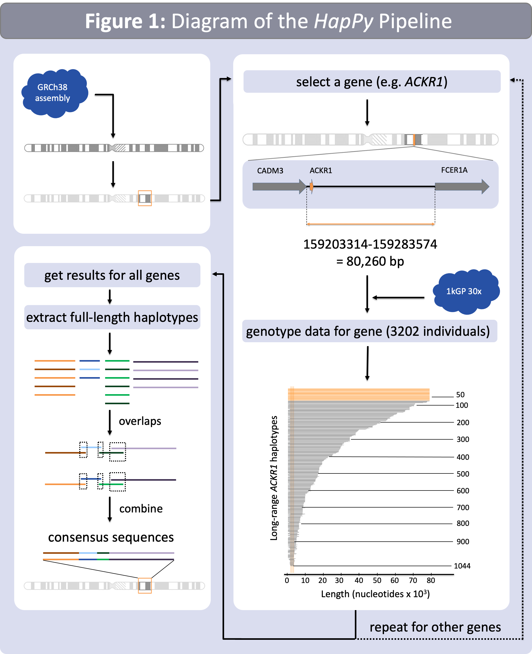
Notes:
Good morning everyone. My name is Anne-Sophie, I work in the DTM under Dr. Flegel and Dr. Srivastava. Today, i will be presenting HapPy, which is an algorithm that uses sequences from the 1000GP for chromosome-scale haplotype reconstruction.
INTRO
So first, let me give you some background. When we sequence a person’s genome, we get genotypes, but genotypes dont tell us which SNVs are inherited together. This info is important bc knowing which SNVs are inherited together is essential to understanding the genetics of diseases. This is why we need something called haplotype phasing, which is the process of inferring haplotypes from genotype data. Most haplotype phasing approaches rely on correct reference sequences.
The current reference genome, which is called hg38, has multiple issues, including the fact that it lacks genetic diversity due to 70% of it coming from one individual, and it lacks long reference sequences for most blood groups. As a result, our lab previously generated references for the Duffy gene by identifying LCSHs, which are regions containing <= 1 heterozygous SNV. LCSHs are interesting bc, if they are found in unrelated individuals across different populations, they have a lower average recombination rate.
Due to our results being very successful in identifying references for the Duffy gene, we wanted to expand our program, which call HapPy, so that it can generate a more diverse reference genome.
METHODS
Now, lets take a look at how HapPy works. So, for this project, we focused on the 100 genes surrounding ACKR1. First, HapPy downloads the locations of these 100 genes from NCBI. Then, the region between the end of the previous gene and the start of the next gene is selected, and this region is downloaded from the 1000GP for all 3202 individuals. HapPy then finds unique long continuous stretches of homozygosity from this data, which produces something called long-range haplotypes as you see here. This is then repeated for all 100 genes. After we have all these long-range haplotypes, HapPy selects only full-length haplotypes (which are haplotypes that span this whole region). It then finds overlaps between these regions and tries all possible combinations , producing consensus sequences.
RESULTS
Moving on to the results. HapPy was able to generate long-range haplotypes for all 100 genes, and at least one full-length hpalotype for each gene.
When we tried to find all possible combinations between neighbouring haplotypes, we ran into a problem. There was an exponential increase in possible combinations as we tried to append more haplotypes to the sequence. As a result, we tried to develop a heuristic (which is a way of finding any solution, but not necessarily the optimal solution). In our heuristic, full-length haplotypes were ranked by their frequency and, when we tried to find combinations, we would sum the rank of the sequence so far with the rank of the next haplotype. If this number exceeded a threshold, we only kept the top 10,000 instances. Using this heuristic, we were able to generate a consensus sequence with only 2 breaks that spanned this entire region (see fig 2).
CONCLUSIONS AND CLINICAL IMPLICATIONS
In conclusion, HapPy was able to identify long-range haplotypes for all 100 genes that it analyzed. These haplotypes can be used as references for genes that lack long references, like ACKR1, bc this method is not affected by genotype phasing errors. Additionally, we found a consensus sequence with 2 breaks spanning the entire region, and this sequence is an improvement to hg38 bc it captures genetic differences from different humans populations.
This work also has clinical implications. For blood group genes, these haplotypes can be used as references to facilitate blood group genotyping between donors and recepients, which can improve survival rates after bone marrow transplantation. Additionally, a more diverse reference genome can aid population-specific studies of genetic basis of diseases.
FUTURE DIRECTIONS
So, what are our next steps? After improving our heuristic so that there a minimal number of breaks, we want to expand HapPy to the remaining genes on chromosome 1 and eventually all genes so that we can generate a more genetically diverse reference genome. We also hope to use these consensus sequences as input for machine learning to predict the risk of certain diseases.
I would like to thank Dr. Flegel and Dr. Srivastava for their outstanding mentorship and the SIP for this amazing experience. Thank you, and I will now open up the floor to questions.
Chromosome 1 figure: https://www.ncbi.nlm.nih.gov/books/NBK22266/
SOURCES: https://www.ncbi.nlm.nih.gov/grc/help/faq/#human-reference-genome-individuals
https://ashpublications.org/blood/article/133/17/1814/275900/Blood-group-genotyping
https://www.internationalgenome.org/announcements/3202-samples-at-high-coverage-from-NYGC/

Slide 3
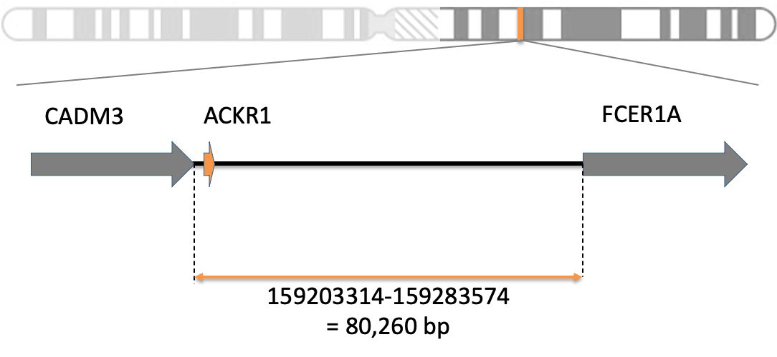
Step 1: Select all protein-coding genes from long arm of chromosome 1
Step 2: Generate haplotypes for genes using long contiguous stretches of homozygosity
extract protein-coding genes on long arm of chromosome 1
select a gene (e.g. ACKR1)
select region between last nucleotide of previous gene and first nucleotide of next gene
Step 3: Build long-range haplotypes from full-length haplotypes for genes
get full-length haplotypes for subset of genes
1000 Genomes 30x on GrCH38
Fetch data
genotype data for gene (3202 individuals)
Extract unambiguous haplotypes by selecting individual sequences with a single site of heterozygosity or complete heterozygosity

Slide 4

CADM3
ACKR1
FCER1A
159203314-159283574
= 80,260 bp

Slide 5

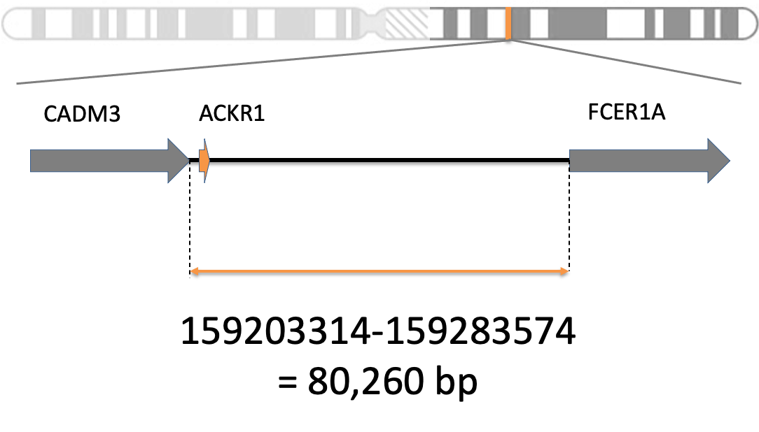
Figure 2: Diagram of the HapPy Pipeline
GRCh38 assembly
select a gene (e.g. ACKR1)
1kGP 30x
get results for all genes
genotype data for gene (3202 individuals)
select full-length haplotypes
long-range haplotypes
repeat for other genes

Slide 6
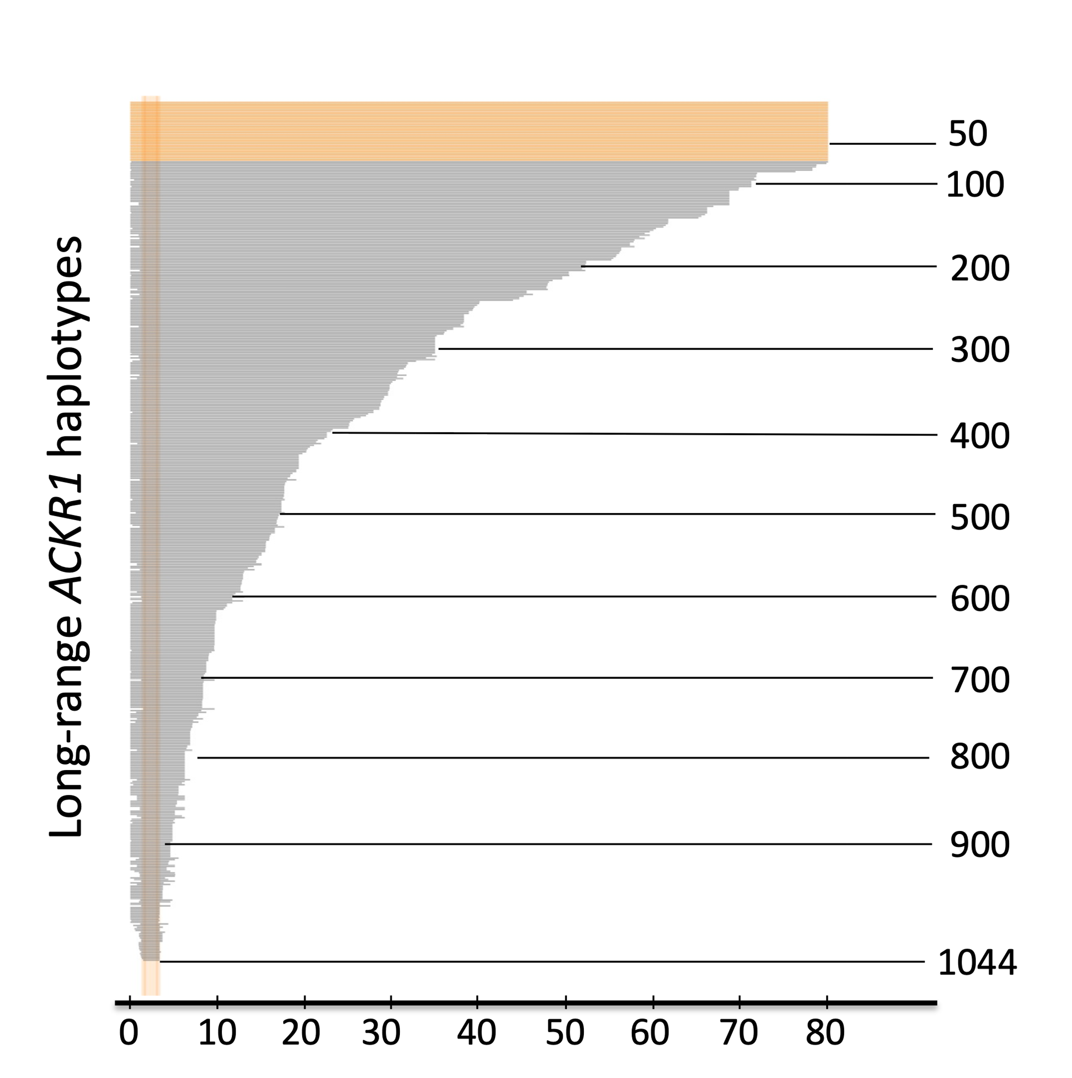
50
100
200
Long-range ACKR1 haplotypes
300
400
500
600
700
800
900
0
10
20
30
40
50
60
70
80
1044
Length (nucleotides x 10³)

Slide 7
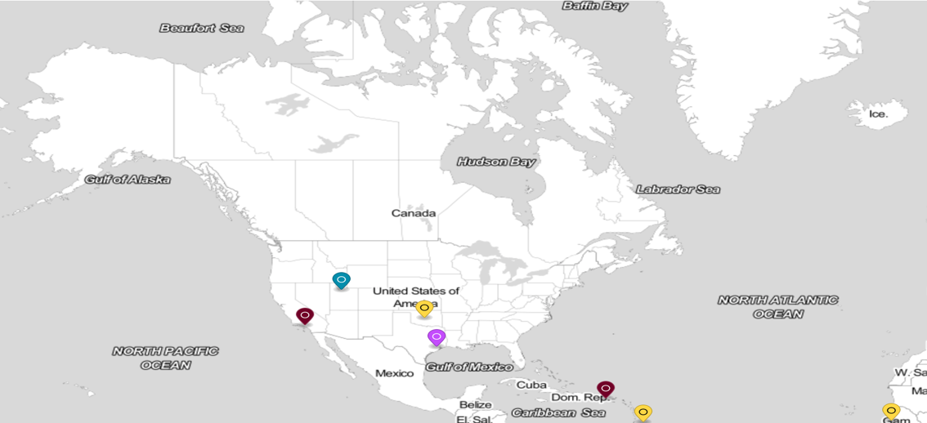
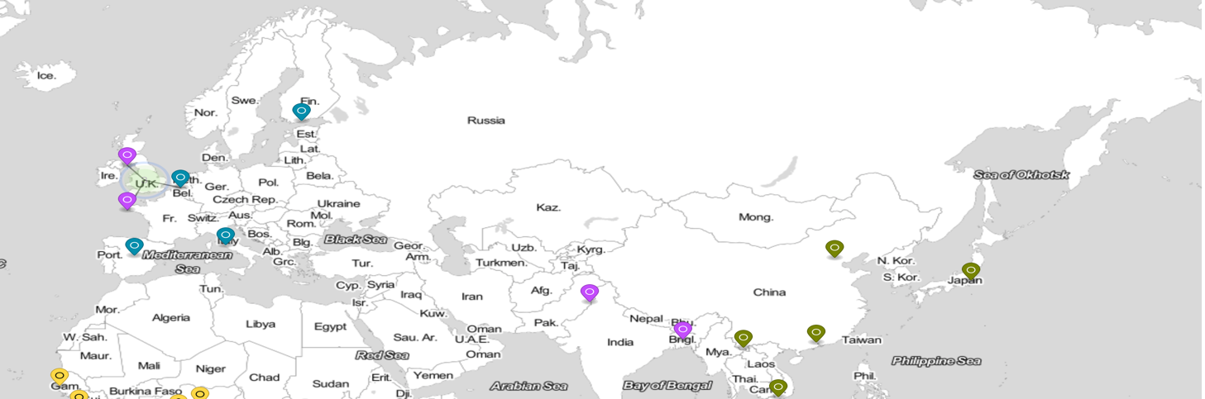
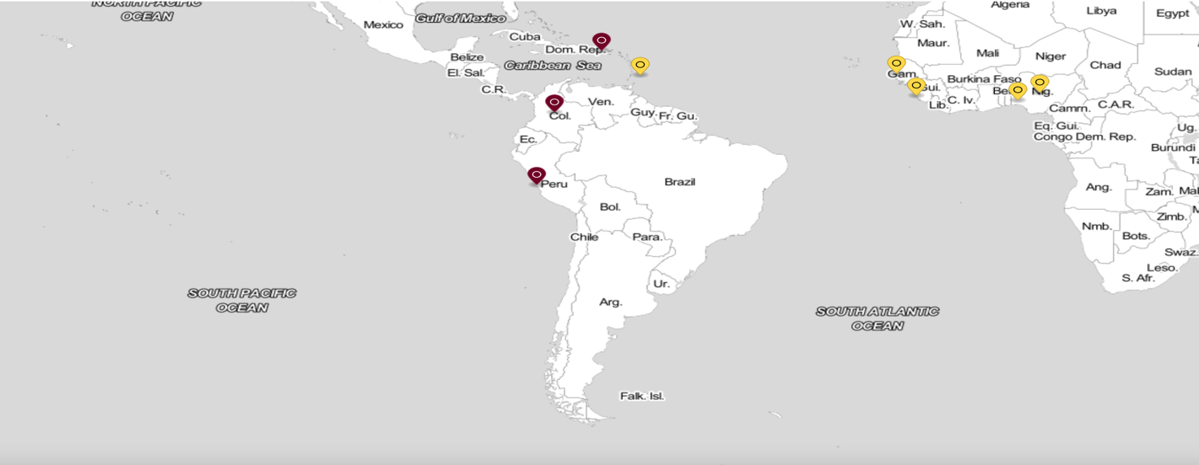
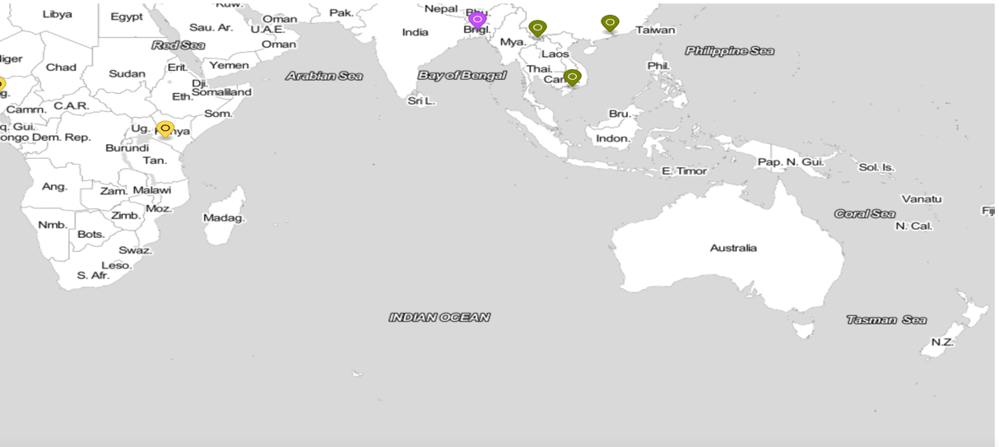
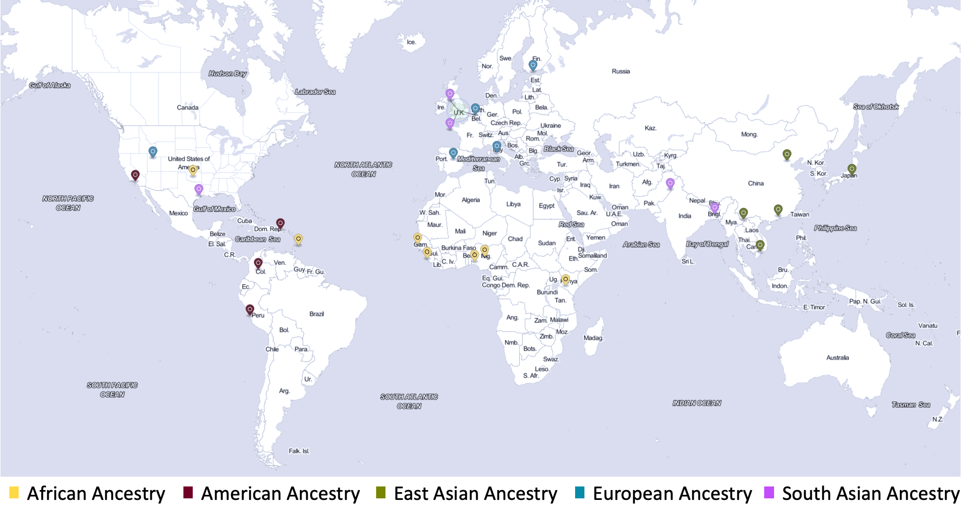
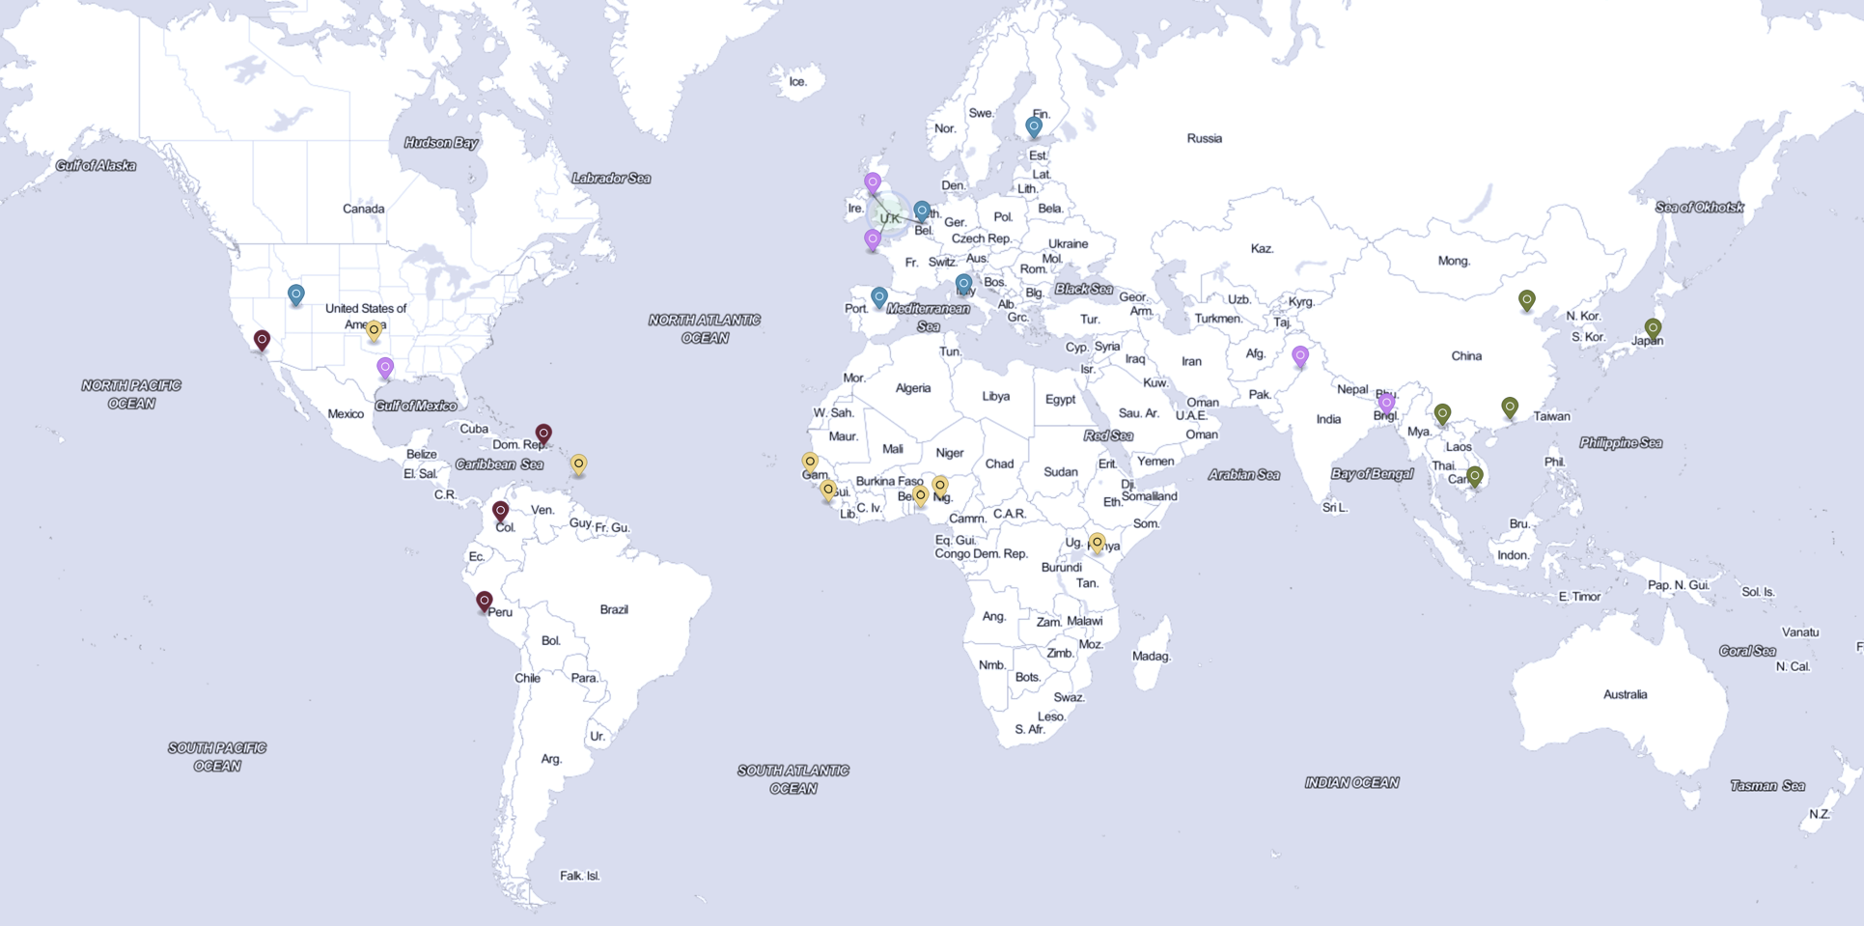
African Ancestry
American Ancestry
East Asian Ancestry
European Ancestry
South Asian Ancestry
Figure 1: Population Distribution for 1kGP 30x

Slide 8
5,760 combinations
9,048 combinations
6,152 combinations
3,219,717 nt
1,370,542 nt
656,311 nt
156,177,747
OR10J1
CD48
161,303,593
SLC25A44
FCER1A
SLAMF1
PCP4L1

